Slide 1


3
Supply and Demand
Revised by Solina Lindahl

Slide 2
WHAT YOU WILL LEARN IN THIS CHAPTER
What is a competitive market?
What are supply and demand curves?
How do supply and demand curves lead to an equilibrium price and equilibrium quantity in the market?
What are shortages and surpluses and why do price movements eliminate them?

Slide 3
COMPETITIVE MARKETS
A competitive market has many buyers and sellers of the same good or service, none of whom can influence the price.
The supply and demand model is a model of how a competitive market behaves.

Slide 4
DEMAND
Demand represents the behavior of buyers.
A demand curve shows the quantity demanded at various prices.
The quantity demanded: the quantity that buyers are willing (and able) to purchase at a particular price.

Slide 5
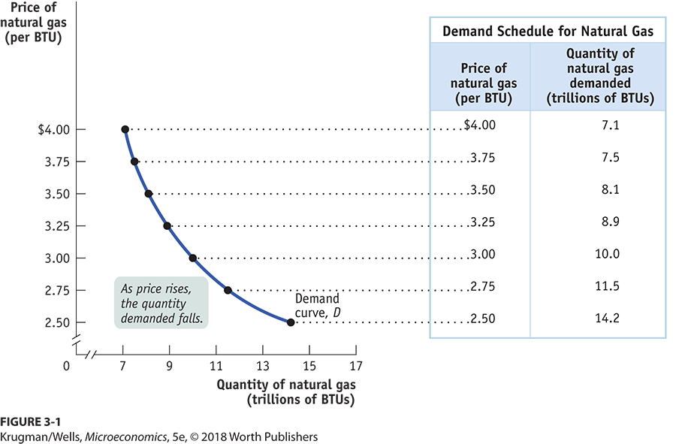
THE DEMAND SCHEDULE AND THE DEMAND CURVE

Slide 6
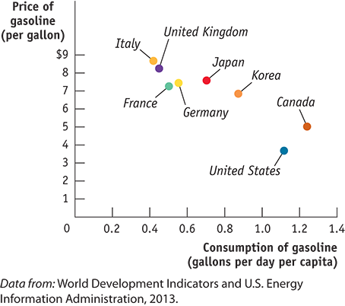
GLOBAL COMPARISON: PAY MORE, PUMP LESS
Higher gas prices in Europe have a predictable effect: less consumption.

Slide 7
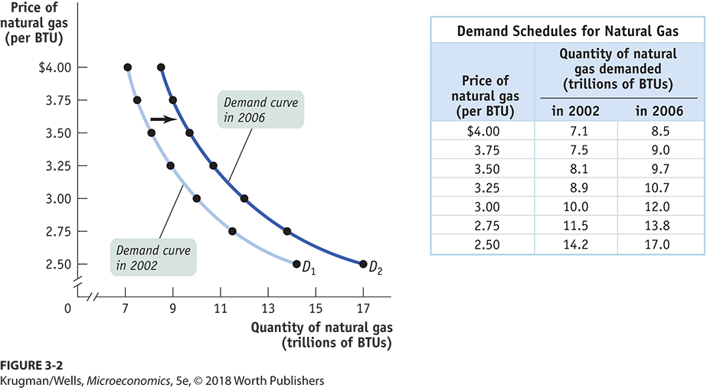
AN INCREASE IN DEMAND
An rightward shift in demand is an “increase” in demand (and vice versa.)

Slide 8
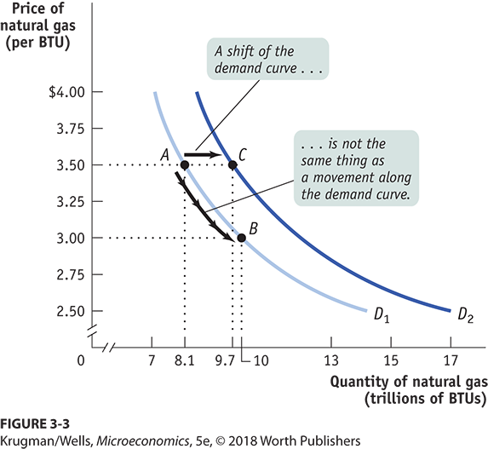
A MOVEMENT ALONG VS. A SHIFT IN DEMAND
When price alone changes, there is movement along a demand curve.
When the demand shifts, people are buying more (or less) at EVERY price.

Slide 9
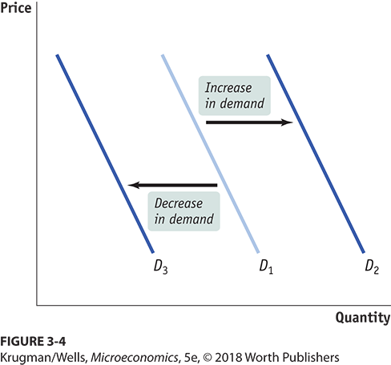
GRAPHING SHIFTS OF THE DEMAND CURVE
Any event that increases demand shifts the demand curve rightward and vice versa.

Slide 10
CHANGES IN PRICE OF RELATED GOODS: SUBSTITUTES
Two goods are substitutes if a decrease in the price of one leads to a decrease in demand for the other (or vice versa).
What happens to the demand for travel in Hawaii if the perceived risk of traveling to the Caribbean increases?

Slide 11
CHANGES IN PRICE OF RELATED GOODS: COMPLEMENTS
Two goods are complements if a decrease in the price of one good leads to an increase in the demand for the other (or vice versa).
Consumers often have to buy goods together.
An increase in price of gasoline will decrease the demand for SUVs.

Slide 12
CHANGES IN INCOME
The effect of changes in income on demand depends on the nature of the good in question.
A normal good: Demand increases when income increases (and vice versa).
An inferior good: Demand decreases when income increases (and vice versa).

Slide 13
CHANGES IN TASTES
Tastes and preferences are subjective and vary among consumers.
Seasonal changes or fads have a predictable effects on demand.
What happens to demand for boots in October?

Slide 14
CHANGES IN EXPECTATIONS (1 of 2)
If consumers have a choice about the timing of a purchase, they buy according to expectations.
Buyers adjust current spending in anticipation of the direction of future prices in order to obtain the lowest possible price.
If prices for the newest Xbox consoles are expected to drop right before Christmas, what will happen to sales during November?

Slide 15
LEARN BY DOING: PRACTICE QUESTION 1
When the price of petroleum goes up, the demand for natural gas ______, the demand for coal ______, and the demand for solar power ______. (Assume these goods are substitutes for petroleum.)
increases; increases; increases
increases; increases; decreases
decreases; decreases; increases
decreases; decreases; decreases

Slide 16
LEARN BY DOING: PRACTICE QUESTION 1 (Answer)
When the price of petroleum goes up, the demand for natural gas ______, the demand for coal ______, and the demand for solar power ______. (Assume these goods are substitutes for petroleum.)
increases; increases; increases (correct answer)
increases; increases; decreases
decreases; decreases; increases
decreases; decreases; decreases

Slide 17
CHANGES IN THE NUMBER OF CONSUMERS
As the population of an economy changes, the number of buyers of a particular good also changes (thereby changing its demand).
What happens to the demand for diapers in Russia as birth rates drop?

Slide 18
LEARN BY DOING: PRACTICE QUESTION 2
Which of the following will cause an increase in the demand for autos?
Price of car tires increases because of a Malaysian rubber shortage.
Concrete steel reinforcing rods are replaced by aluminum along the Atlantic coast to prevent rusting.
Gasoline prices drop by 50% when OPEC nations increase production.
McDonald’s increases its hamburger production in response to consumer trends.

Slide 19
LEARN BY DOING: PRACTICE QUESTION 2 (Answer)
Which of the following will cause an increase in the demand for autos?
Price of car tires increases because of a Malaysian rubber shortage.
Concrete steel reinforcing rods are replaced by aluminum along the Atlantic coast to prevent rusting.
Gasoline prices drop by 50% when OPEC nations increase production. (correct answer)
McDonald’s increases its hamburger production in response to consumer trends.

Slide 20
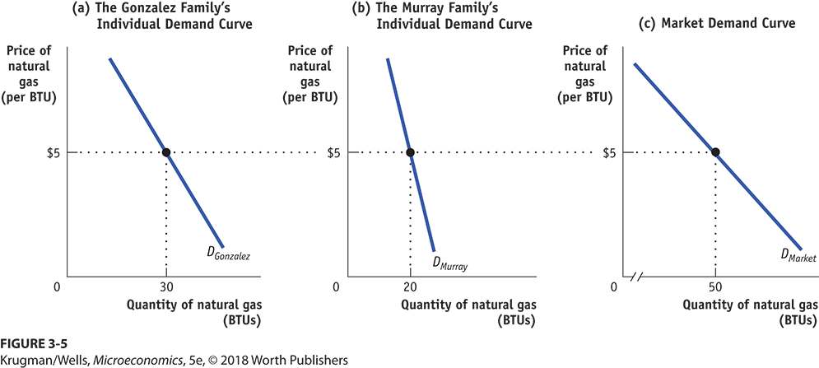
INDIVIDUAL DEMAND CURVES AND THE MARKET DEMAND CURVE
The market demand curve is the horizontal sum of the individual demand curves of all consumers.

Slide 21
SUPPLY
Supply represents the behavior of sellers.
A supply curve shows the quantity supplied at various prices.
The quantity supplied is the quantity that producers are willing and able to sell at a particular price.

Slide 22
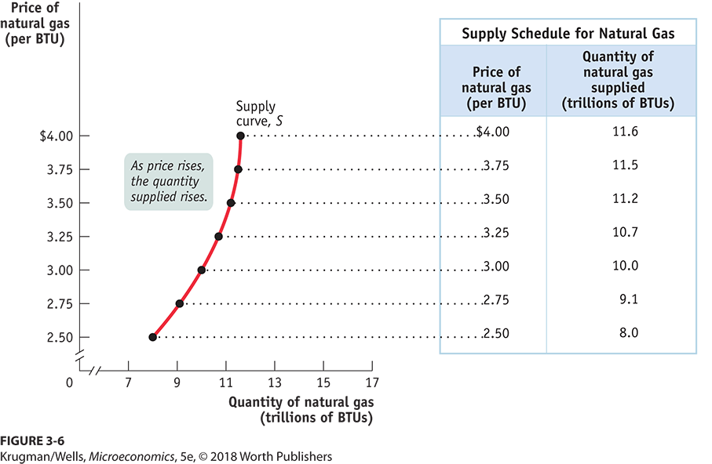
THE SUPPLY SCHEDULE AND THE SUPPLY CURVE

Slide 23
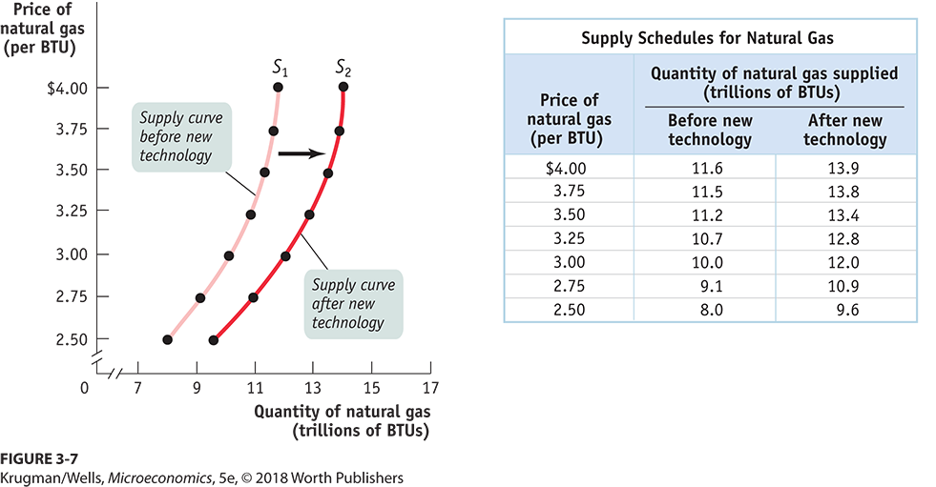
SHIFTS OF THE SUPPLY CURVE PART 1

Slide 24
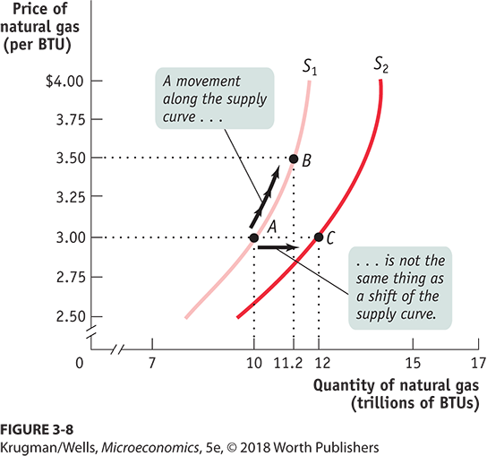
MOVEMENT ALONG THE SUPPLY CURVE VERSUS SHIFT OF THE SUPPLY CURVE

Slide 25
UNDERSTANDING SHIFTS OF THE SUPPLY CURVE
Important supply shifters include changes in:
input prices.
the prices of related goods or services.
technology.
expectations.
the number of producers.

Slide 26
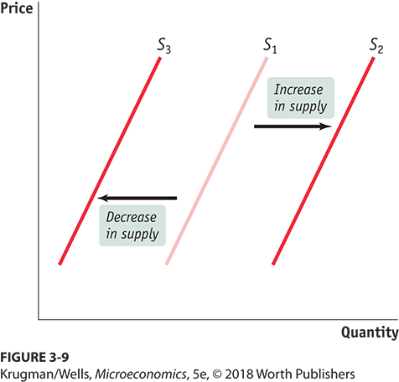
SHIFTS OF THE SUPPLY CURVE PART 2

Slide 27
CHANGES IN INPUT PRICES PART 1
A decrease in the price of an input (all else equal) increases profits and encourages more supply (and vice versa).
What will happen to the number of new businesses if the government reduces the fees and red tape associated with new business licenses? What happens if the fees rise?

Slide 28
CHANGES IN INPUT PRICES PART 2
Inputs used in production have opportunity costs. Sellers will choose to use inputs whose profit is the highest.
Sellers will supply less of a good if its profitability falls (and vice versa).
There are substitutes and complements in production processes.
Complement in pork processing? Lard.
Substitute in corn production? Cotton.

Slide 29
CHANGES IN TECHNOLOGY
New, better technology makes sellers willing to offer more at a given price or sell their quantity at a lower price.
A technological innovation lowers costs and increases supply.

Slide 30
CHANGES IN EXPECTATIONS (2 of 2)
The expectation of a higher price for a good in the future decreases current supply of the good – if they can store the good (and vice versa).
Sellers will adjust their current offerings in anticipation of the direction of future prices in order to obtain the highest possible price.

Slide 31
CHANGES IN NUMBER OF PRODUCERS
As producers enter and exit the market, the overall supply changes.
Entry implies more sellers in the market, increasing supply.
Exit implies fewer sellers in the market, decreasing supply.
As more firms enter the solar installation market, the number of solar installations available for sale increases.

Slide 32
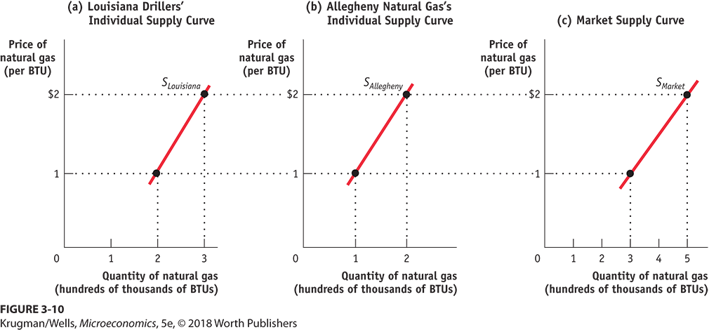
THE INDIVIDUAL SUPPLY CURVE AND THE MARKET SUPPLY CURVE
The market supply curve is the horizontal sum of the individual supply curves of all producers.

Slide 33
SUPPLY, DEMAND AND MARKET EQUILIBRIUM
When Q_{s} = Q_{d} at a certain price, the market is in equilibrium.
That is, the amount consumers would purchase at this price is matched exactly by the amount producers wish to sell.

Slide 34
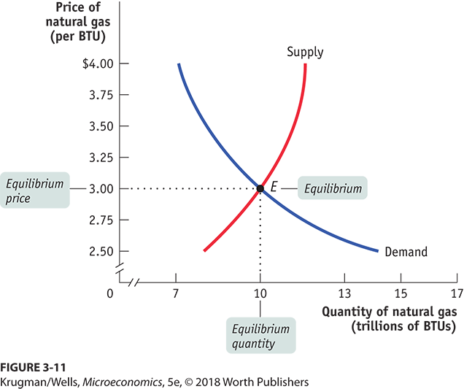
FINDING THE EQUILIBRIUM PRICE AND QUANTITY
The price at which this takes place is the equilibrium price, also referred to as the market-clearing price. The quantity of the good or service bought and sold at that price is the equilibrium quantity.

Slide 35
WHY DO ALL SALES AND PURCHASES IN A MARKET TAKE PLACE AT THE SAME PRICE?
Where consumers don’t have time to compare prices (like a tourist trap), different stores have different prices.
In well-established markets, there is a uniform price.

Slide 36
WHY DOES THE MARKET PRICE FALL IF IT IS ABOVE THE EQUILIBRIUM PRICE?
There is a surplus of a good when the quantity supplied exceeds the quantity demanded. Surpluses occur when the price is above its equilibrium level.
Surpluses do not last: sellers will reduce price so they can move goods off the shelves.

Slide 37
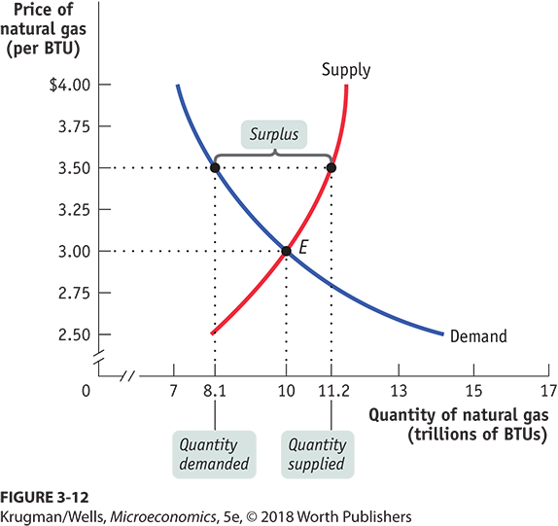
PRICE ABOVE ITS EQUILIBRIUM LEVEL CREATES A SURPLUS
This surplus will push the price down until it reaches the equilibrium price of $3.

Slide 38
WHY DOES THE MARKET PRICE RISE IF IT IS BELOW THE EQUILIBRIUM PRICE?
There is a shortage when the quantity demanded exceeds the quantity supplied. Shortages occur when the price is below its equilibrium level.
Shortages do not last: sellers will increase price to increase revenue.

Slide 39
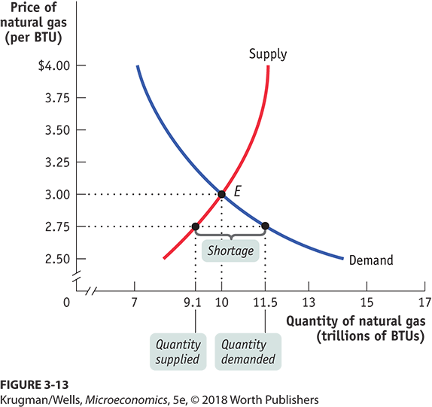
PRICE BELOW ITS EQUILIBRIUM LEVEL CREATES A SHORTAGE
This surplus will push the price down until it reaches the equilibrium price of $3.

Slide 40
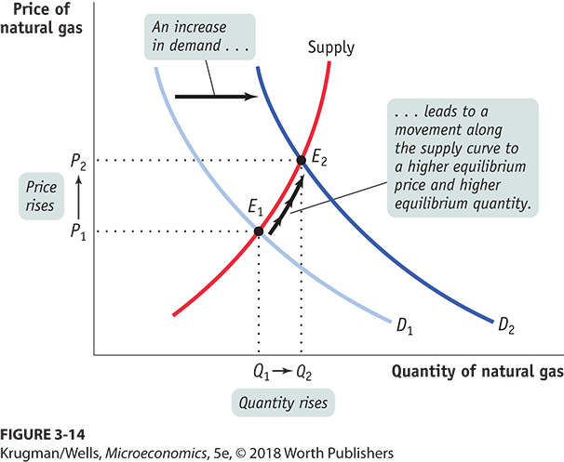
WHAT HAPPENS WHEN THE DEMAND CURVE SHIFTS?
An increase in demand leads to a movement along the supply curve to a higher equilibrium price and higher equilibrium quantity.

Slide 41
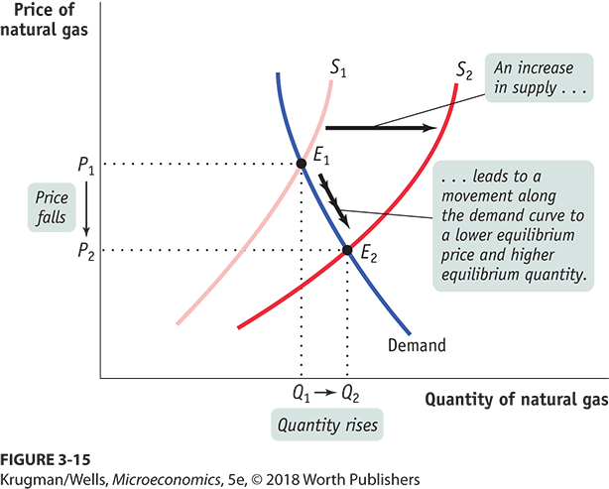
WHAT HAPPENS WHEN THE SUPPLY CURVE SHIFTS?
An increase in supply leads to a movement along the demand curve to a lower equilibrium price and higher equilibrium quantity.

Slide 42
LEARN BY DOING: PRACTICE QUESTION 3
If garden gnomes regain popularity, what will happen?
Equilibrium price and quantity both fall.
Equilibrium price and quantity both rise.
Equilibrium price falls and quantity rises.
Equilibrium price rises and quantity falls.

Slide 43
LEARN BY DOING: PRACTICE QUESTION 3 (Answer)
If garden gnomes regain popularity, what will happen?
Equilibrium price and quantity both fall.
Equilibrium price and quantity both rise. (correct answer)
Equilibrium price falls and quantity rises.
Equilibrium price rises and quantity falls.

Slide 44
LEARN BY DOING: PRACTICE QUESTION 4
If the cost of wood falls, what will happen to equilibrium price and quantity in the violin market?
Both fall.
Both rise.
Price falls and quantity rises.
Price rises and quantity falls.

Slide 45
LEARN BY DOING: PRACTICE QUESTION 4 (Answer)
If the cost of wood falls, what will happen to equilibrium price and quantity in the violin market?
Both fall.
Both rise.
Price falls and quantity rises. (correct answer)
Price rises and quantity falls.

Slide 46
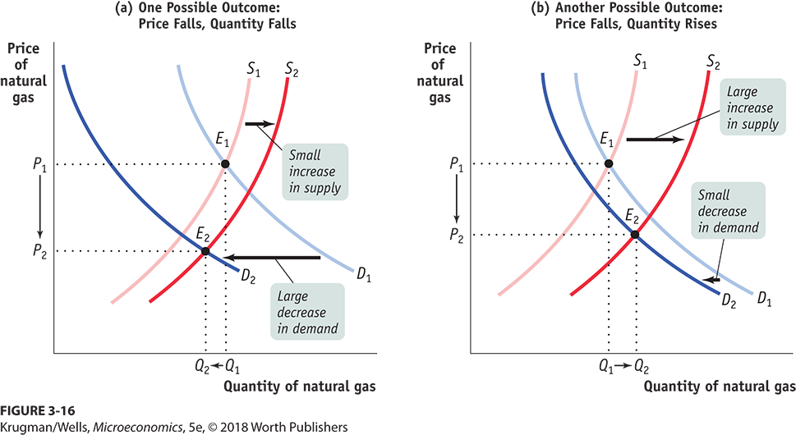
SIMULTANEOUS SHIFTS OF THE DEMAND AND SUPPLY CURVES
If the decrease in demand is relatively larger than the increase in supply, the equilibrium price and quantity falls.
If the increase in supply is large relative to the decrease in demand, the equilibrium quantity rises as the equilibrium price falls.

Slide 47
LEARN BY DOING: PRACTICE QUESTION 5
Consumers in Mayville consider houses and apartments to be substitutes. There is an increase in the price of houses in Mayville at the same time three new apartment buildings open there. In the market for apartments in Mayville:
the equilibrium price will rise.
the equilibrium price will fall.
the equilibrium quantity will rise.
the equilibrium quantity will fall.

Slide 48
LEARN BY DOING: PRACTICE QUESTION 5 (Answer)
Consumers in Mayville consider houses and apartments to be substitutes. There is an increase in the price of houses in Mayville at the same time three new apartment buildings open there. In the market for apartments in Mayville:
the equilibrium price will rise.
the equilibrium price will fall.
the equilibrium quantity will rise. (correct answer)
the equilibrium quantity will fall.

